Slide 1
Pacific school of engineering
Group-D
Valani Tusar
Nayani Ankit
Pansuriya Vishal
Patel Hardik
Chohan Kaushik
Guide by
Mr. Hiten kheni
Civil Engg. Dept

Slide 2
Traffic And Traffic Control
Idaho Traffic Laws
You must stop:
Before a stop line or crosswalk.
If there are no lines, stop before entering the intersection.
For any red light or sign, flashing or solid.
For a pedestrian crossing within a marked or unmarked crosswalk.
At a railway crossing when a train is coming or when train signals, gates, or signs indicate an approaching train.
When entering a street from an alley, building, driveway, or private road.
At the request of any police officer.
For emergency or police vehicles sounding a siren or flashing red or blue lights.

Slide 3
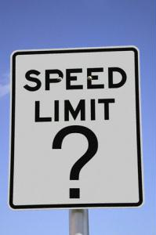
Speed Limits
The Basic Rule:
The maximum speed on a freeway is 75mph, 65mph on a highway, and 35mph on city streets (unless posted otherwise).
It is illegal to drive so slowly that you disrupt the normal flow of traffic.
Observe posted speeds in school and construction zones to protect students and workers (penalties are higher in these areas).

Slide 4
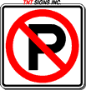
No Parking Zones
On the street-side of any other parked vehicle (double parking)
On bridges or overpasses
In front of a driveway
Within 15’ of a fire hydrant
Within 20’ of a crosswalk
Within 20’ of a fire station driveway
Within 30’ of a stop sign, yield sign, or traffic signal
On a freeway
Where prohibited by signs or a red, yellow, or white “no parking” curb.

Slide 5
Fact About Signaling & Turning
You must signal when changing lanes.
You must signal when entering or leaving the freeway.
You must signal when pulling toward or away from the curb.
You must signal 100 feet (about 5 seconds) before turning.
In Idaho, you may turn right on a red light, after stopping.

Slide 6
Traffic signs have three purposes:
Regulate traffic, movement or parking
Warn of potential dangers or road conditions
Provide information and guidance

Slide 7
Colors Have Meaning
Red
Green
Blue
Yellow
Black
White
Orange
Brown
Fluorescent Optic Yellow

Slide 8
Three Types of Signs
Regulatory
Warning
Guide

Slide 9
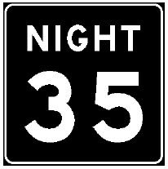
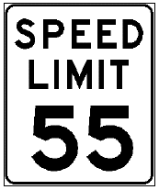
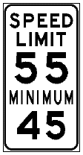
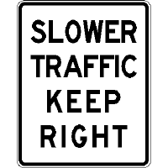
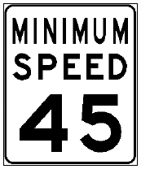
Speed Limits
Urban Areas
Parks
Rural Interstate
Urban Interstate
School Zones

Slide 10
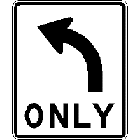
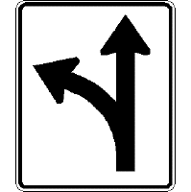
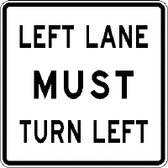
Other Regulatory Signs

Slide 11
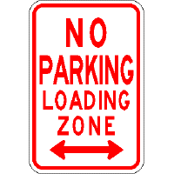
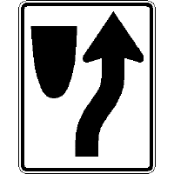
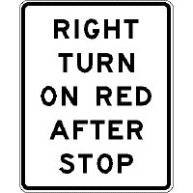
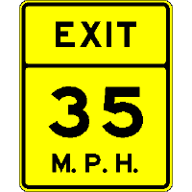

Slide 12
Types of Work Zones
Stationary
Work Areas
Moving
Work Areas

Slide 13
Tips for Driving Through Work Zones:
Fines double in a work zone!
Proceed with extreme caution
Drive at the posted speed
Watch out for workers
Stay in your lane
Report unsafe conditions

Slide 14
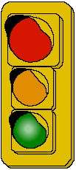
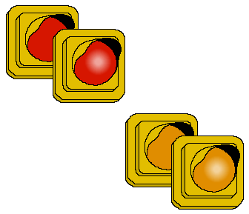
Signals
Steady lights
Flashing lights
Signal/Sign combinations
NO TURN ON RED

Slide 15
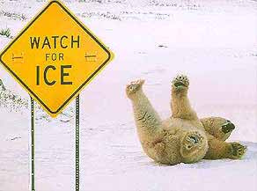
Thank You.

